Slide 1
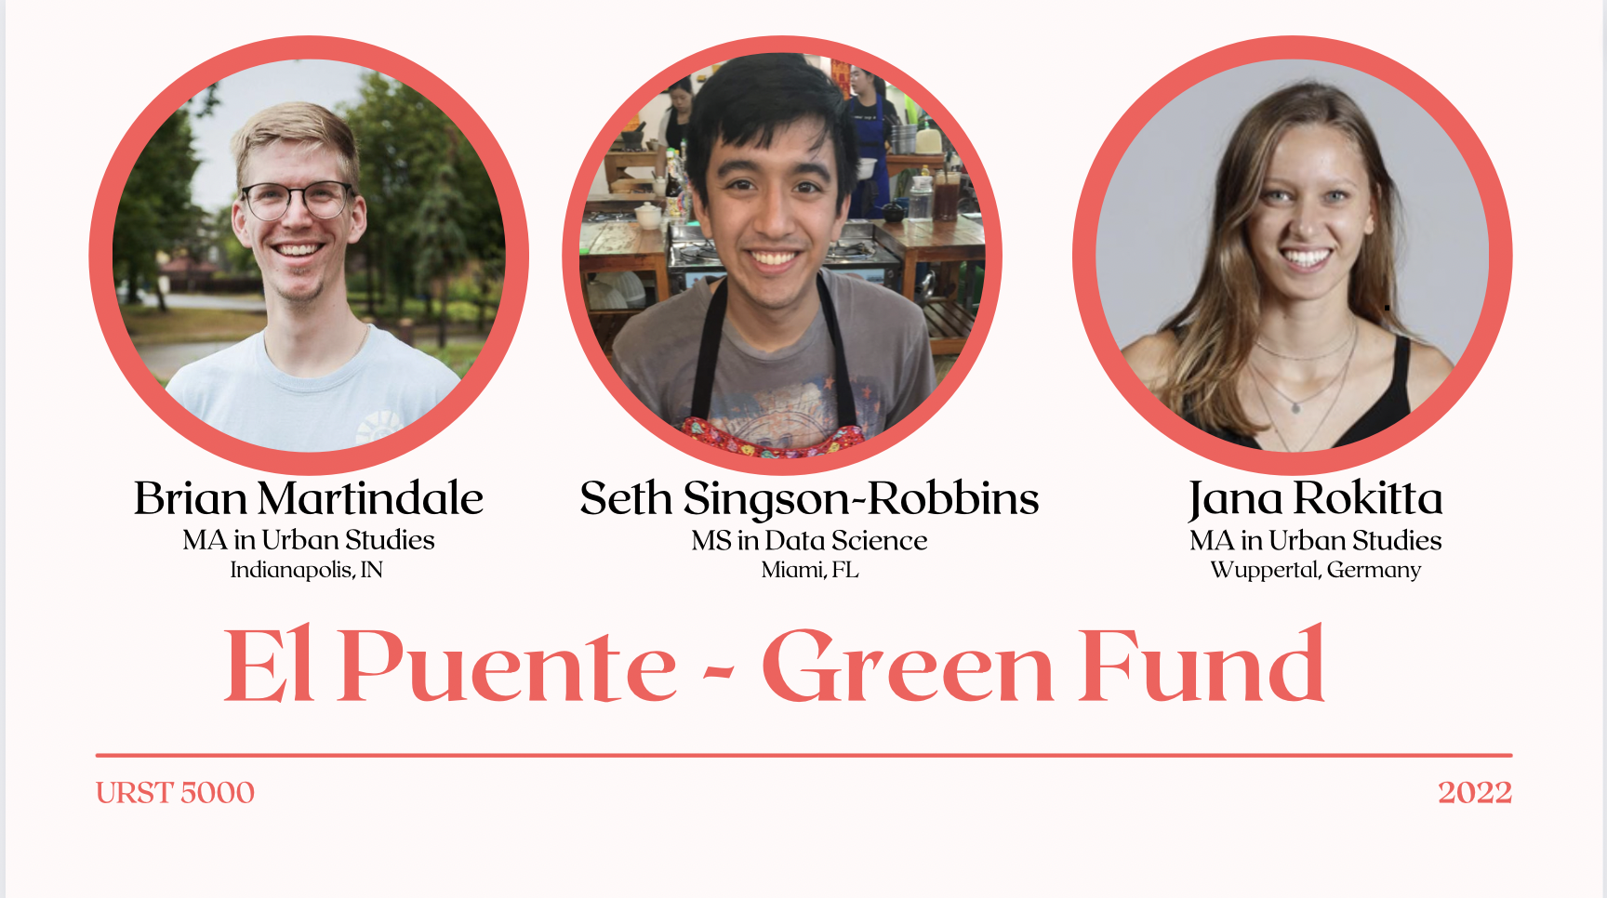

Title If Allowed
Notes:
Jana
Seth Singson-Robbins - Miami, FL
Brian Martindale - Indianapolis, IN
Our names are…. Master of…
city council approved the development project on Williamsburg's waterfront last year,
Community worried that the project will raise living costs and take away community spaces in a neighborhood that is already affected by environmental injustices.
As Two Trees partly acknowledged the harm for the neighborhood received a Green Fund to support community projects benefiting environmental justice.
We will present our allocation of funds, grant administration, application and review process
30 seconds

Slide 2
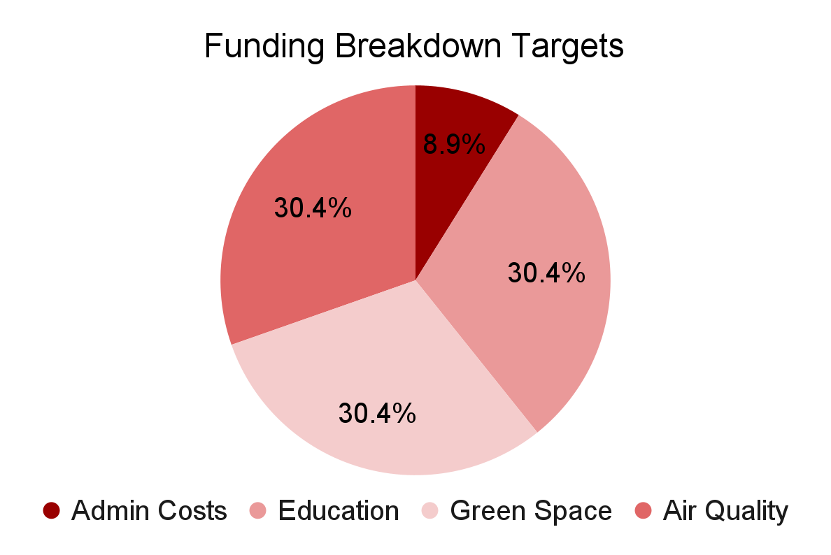
Allocation of Funds
Grant Administration - 8.9%
Grant Allocation - 91.1%
Category allocation is a target, will prioritize equal distribution but not guaranteed
$50k/year max per project
Expected $200k in the 1st year:
1 large project per category plus extra money for smaller projects
Timing
Will be allocated based on what is available and needed to complete grant
Will postpone approved projects if funds received later
Notes:
9% on Admin costs (will explain in the next slide)
91% towards grant
Not set amounts per category but targets for equal reach
Spend per grant at $50k/year
Based on project allocation given by Greenpoint Community Environmental Fund and other funds
Timing of grant allocation based on need and what’s available
Not tiers or allocation divide between individuals and organizations
Gives opportunities for people in the community with less prior opportunities to have a chance of being picked for their innovative ideas

Slide 3
Grant Administration
Actual: 8.9%
$15,600 per year
8.7% Goal
15 hours per week
$20 per hour
Manage grant
Direct interns
Preferred from neighborhood
Assist Grant Coordinator
School credit
Non-profit experience
From neighborhood
Unpaid
Grant Coordinator
High School Internship
Notes:
8.7% Goal based on voluntary survey of 309 organizations. Of those who were “pass through” entities, their average admin cost was 8.7%
Hire of 1 part time grant coordinator
15 hours, 3-6pm
Market and outreach, assist application process, direct review process, offer support to grantees
Manages the high school interns
Unpaid, from community
Work with the project grant recipients and other coordination projects
Marketing and outreach, application input, application support
Could be class credit for school
Get experience in non-profit admin, advocate for community

Slide 4
Application Parameters
HOW
WHO
Individuals
Organizations
Start-ups
Online & Paper
Application assistance
Spanish & English
Focus on equal opportunities and avoiding biases
CATEGORIES
LENGTH/
RENEWAL
Green Space
Air Quality
Education
→ avoiding further Gentrification
Up to 3 year funding
Max $50k per project per year
Renewal opportunities
Notes:
Jana
I will describe more about the fund and who and how to apply and then afterwards brian will describe the actual application process
WHO:
Application will be open to all individuals or organizations from the community
Start-ups are welcome based on what el Puente said: no restrictions on existence time: however, require some prior experience in project planning & business plan etc: (brian will go more in depth about actual application process)
Categories:
Categories of funding we prioritize projects targeting urban green space, air quality, and environmental education with a focus on community involvement and counteracting gentrification however we are open to other projects that fall into the environmental justice spectrum
Green space: El Puente pointed out that through the development project on the WIlliamsburg waterfront, the community will lose green space. That made it a priority for us. Additionally, green spaces can reduce emissions and since the neighborhood is facing air quality problems this will be very beneficial. Lastly, green spaces provide a place to bring together the community and to be physical active and can have physical and mental health benefits for community members
It was important for us to address air quality. It is the biggest environmental hazard of the area which requires action. Air monitoring systems in the neighborhood already exists.
Education is essential to keep the change going in future generations. Involving youth in development projects can empower them in regard to their future careers and help them identify the needs of the community.
HOW:
Our call for proposal and info sheet will be emailed out to community members and organizations, published on our website, (publish somewhere else)
We looked at a few potentinal organizations in the neighborhood and fund that there are many that might be interested like Los sures united, north Brooklyn mutual aid, times up, or riseBoro)
The application itself can be filled out online, or a paper copy can be picked up at the el Puente office
Additionally, as mentioned in the allocation of funds, el Puente stuff will assist with applications especially for individuals and provide assistance in Spanish and English (applications will also be available in Spanish)
The high school interns that seth talked about earlier will be responsible for entering paper based applications into the online system so that all applications can be evaluated unbiased without being influenced by whether they were filled out on paper or online
Length/renewal:
Individuals and organizations can apply for funding for up to 3 years with a max of $50k per year → in application state needed funding
At the end of their grant period, they can apply for renewal
However misconduct will result in discontinuation of funds and support
Operate on a trust-based philanthropy like describes by rami & dani
Want to give the money to the community directly and support those who don’t have the same means to apply
3.45 min

Slide 5
Application
Basic Information
Plan
Values
Experience
Twelve Principles
Organization
Goals
Past Projects
Name
Gentrification Prevention
Budget
Summary
Reference
Address
Environmental Justice
Timeline
Accessibility
Digital and Paper
Staff Support
Language
Notes:
Project Required Questions: What rationale do individuals and groups need to present in order to receive funding? (look for potential groups or individuals)
Basic information: Individual or organization name and address ensure that applicants are members of the community.
Plan: Practical dimensions of the project plan, such as a summary, goals, budget, and timeline, provide applicants a structure for preparing their project and provide reviewers necessary information for the approval process.
Values: Articulation of the project’s connection to environmental justice, the Twelve Principles of El Puente, and the prevention of gentrification ensure the project aligns with the values of the Green Fund.
Experience: A description of the applicant’s ability, either through previous successful projects or a friendly letter of recommendation, ensures grant money will be in capable hands.
Accessibility: The application will be available in both English and Spanish, as well as online and on paper. Support will be available at El Puente from the Grant Coordinator and volunteers to ensure accessibility to all potential applicants.
BRIAN - MAKE FEWER WORDS

Slide 6
Review Process
Feasibility
(Development)
Project Value
(Unity Through Diversity)
Project’s Innovation
(Creativity)
Relevance of Project (Holism)
Innovation of Project
(Creativity)
Project Self Reliance
(Mentoring)
Success to Goal
(Mastery)
Gentrification
(Safety)
People Benefiting
(Creating Community)
Relevance to Two Trees Development
(Peace and Justice)
Notes:
Each category is aligned with one of El Puente’s 12 values
Category Review Process
Up to 5 points each category, scores go from 0 to 3-5 so could have 0 but would be very detrimental
Gentrification is required, score of 0 is automatic rejection
Looking at past experience and references, doesn’t have to be project specific and could be work/school related
Two Trees - want to make sure projects specifically affected by the development get prioritized
Project grant money
Projects time will be funded based on what was filled out in the application, can be renewed
Best projects will be picked based on most number of points along with board discussion
Could be timed to be later based on available funds or if need time to fully develop with team
Business Plan Contingency - Approval with money could be given to further improve their business plan if good start but more development of the project needed for approval

